Slide 1
Quarter 4: Environmental Impacts

Slide 2

NGSS Standards Covered in Quarter Four
Quarter 4:
ESS3-5- Current rate of global climate change & Future Impacts click here to access the standard
ESS2-4- Model of energy flow to result in change in weather and climate- Increase CO2 increase global warming/ Large Volcanic Eruptions click here to access the standard
ESS3-6- Environment modified by human activity through earth’s spheres click here to access the standard
ESS2-2- Feedback- Melting glaciers reduce albedo click here to access the standard
ESS2-6- Carbon cycle click here to access the standard
ESS 2-7- Evolution of Early atmosphere * click here to access the standard
PS3-3- Device to convert one form of energy to another form of energy click here to access the standard

Slide 3
UNIT 4: CLAIM-EVIDENCE-REASONING (CER)
It is imperative that you regularly practice CER with your students throughout each unit.
Students will be required to write many constructed responses on the MISA.
Writing in the content will not only help students improve their writing skills, but also their analysis and reasoning skills which will also benefit them on the PARCC.
UNIT 4 CER’s:
Albedo
Global Warming
Weather Predictions
Resource 1
Resource 2
Resource 3

Slide 4
Unit 19 – Climate Change

Slide 5
Chapter 1 – Introduction

Slide 6
Chapter Four: Climate Change
ESS2-2- Feedback- Melting glaciers reduce albedo click here to access the standard
ESS3-5- Current rate of global climate change & Future Impacts click here to access the standard
ESS3-6- Environment modified by human activity through earth’s spheres click here to access the standard

Slide 7
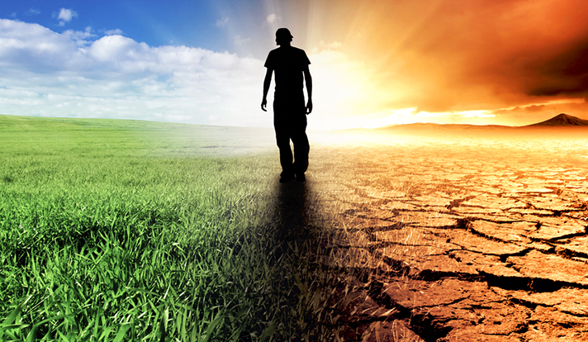
CLIMATE CHANGE
Climate change: a change in global or regional climate patterns - can be natural or man driven.
Global warming: a gradual increase in the overall temperature of the earth's atmosphere generally attributed to the greenhouse effect caused by increased levels of carbon dioxide.
How do we reduce climate change?
REDUCE CARBON EMISSIONS!!!
- clean energy
- reduce our carbon footprint
Higher carbon emissions leads to GLOBAL WARMING which causes CLIMATE CHANGE.

Slide 8
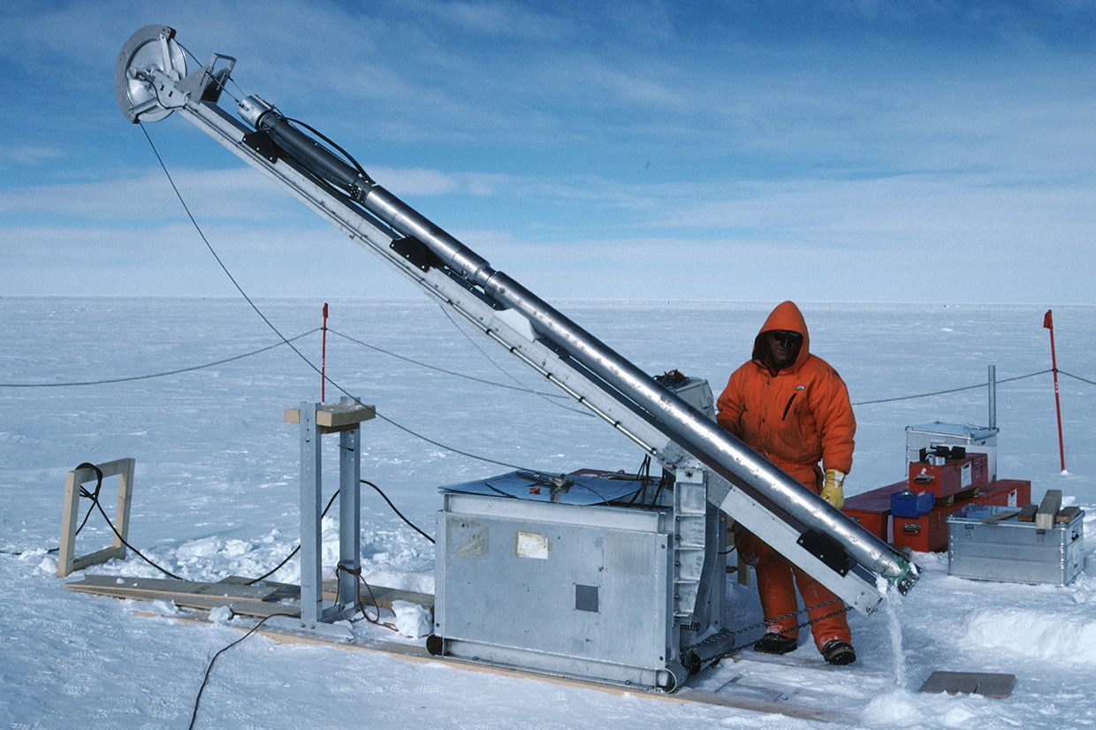
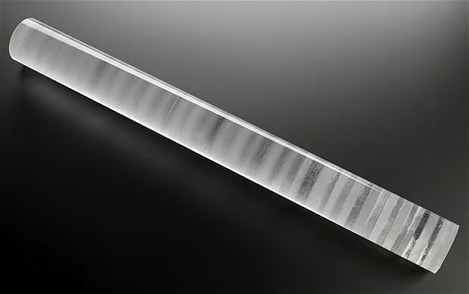
CLIMATE CHANGE - The Evidence Collection
Using ice cores, we can measure the Earth’s temperature and the levels of carbon dioxide in the air over a hundred thousand years.

Slide 9
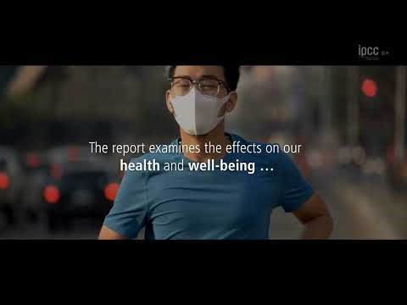

Slide 10
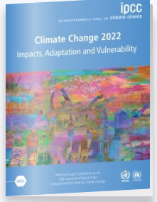
International Panel on Climate Change (IPCC)
“The scientific evidence is unequivocal:
climate change is a threat to human wellbeing and the health of the planet.
… This report offers solutions to the world.”
Keep the Earth’s temperature to 1.5-2°C above Pre-Industrial Levels!
67 Countries, ~900 Authors and Contributors, 34,000 scientific papers!

Slide 11
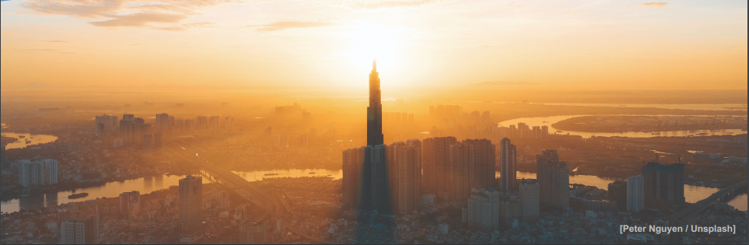
What does the Report Say?
Global warming has caused widespread disruption in nature
Affects the lives of billions of people, despite efforts to adapt
Impacts are magnified in cities (where most people live)

Slide 12
What does the Report Say?
Better understanding of connections
Climate change combines with:
  unsustainable use of natural resources
  habitat destruction
  growing urbanization
  inequity
3.3 – 3.6 billion people live in hotspots of high

Slide 13
What does the Report Say?
Avoid >1.5-2°C
by 2050
Goal:
50% Chance IF Greenhouse Emissions Peak by 2025
To hit the 1.5°C target, the following must happen by 2050:
Coal ↓ 95%
Oil ↓ 60%
Natural Gas ↓ 45%

Slide 14
What does the Report Say?
What happens at 1.5 degrees on Land?
More Hot Days - 14% see Extreme Heatwaves (2°: 37%)
Drought and Decreased Water Availability (2°: ↑61 Million)
Extreme Rains: Leads to Flooding, Runoff and Erosion
Stronger Tropical Storms with Higher Rainfall totals
Loss of Biodiversity and Species, Changing Biomes (2°: ~20%)
Increases in Fires, Extreme Weather and Invasive Species

Slide 15
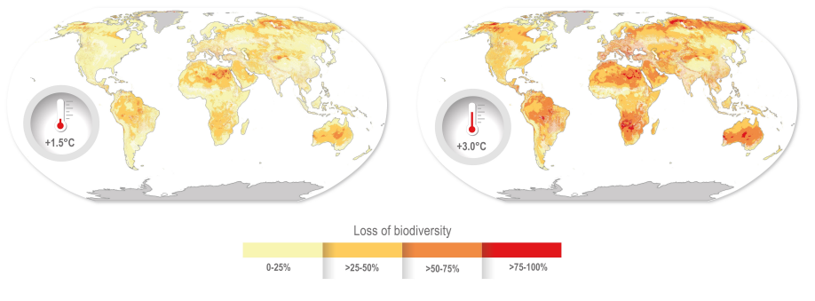
What does the Report Say?
Loss of biodiversity
Climate change combines with:
  unsustainable use of natural resources,
  habitat destruction,
  growing urbanization
  inequity
3.3 – 3.6 billion people live in hotspots of high
What happens if you raise the thermostat 1/2 degree at home?

Slide 16
What does the Report Say?
What happens at 1.5 degrees in the Ocean?
Sea Level Rises of up to 4-6” (2°: 8-9” and covers 70% of Coasts)
Loss of Ice Caps (2°: 6 feet of sea level rise)
↑ Temperature, ↑ Acidity, ↓ Oxygen = ↓ Survival
Coral Reefs Decline 70-90% (2°: Near TOTAL LOSS)

Slide 17
What does the Report Say?
What happens at 1.5 degrees to humans?
↑ Heat-related Illness and Death
↑ Vector-borne diseases (like malaria)
↓ Food Security
U.S. could lose $446 billion in Gross Domestic Product
Loss of small islands, coastal and low-lying areas
  Fiji, Charleston SC, New Orleans, etc.
  40,000 more people affected at 2°

Slide 18
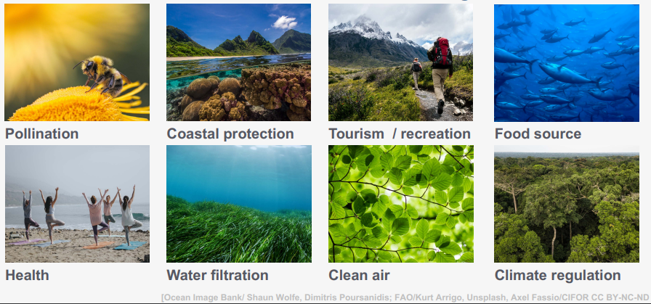
Human Impact

Slide 19
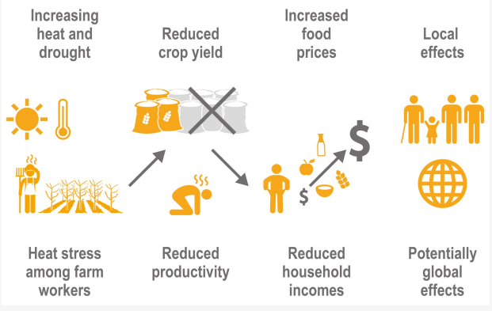
What does the Report Say?
Simultaneous extreme events compound risk
Complexity is tough to manage

Slide 20
CLIMATE CHANGE
Using ice cores, we can measure the Earth’s temperature and the levels of carbon dioxide in the air over a hundred thousand years.
Use a graph with both carbon dioxide levels and global temperature change to see their relationship with each other.

Slide 21
Write a paragraph describing the scientific evidence relating to CO2 and temperature. Use at least 3 pieces of evidence from the graphs in your explanation.
Claim-What is happening in the graphs, Evidence- Use specific information from the graphs, Reasoning- Why is that what’s happening

Slide 22
Environmental Science A Historical Record Data Activity (Optional)

Slide 23
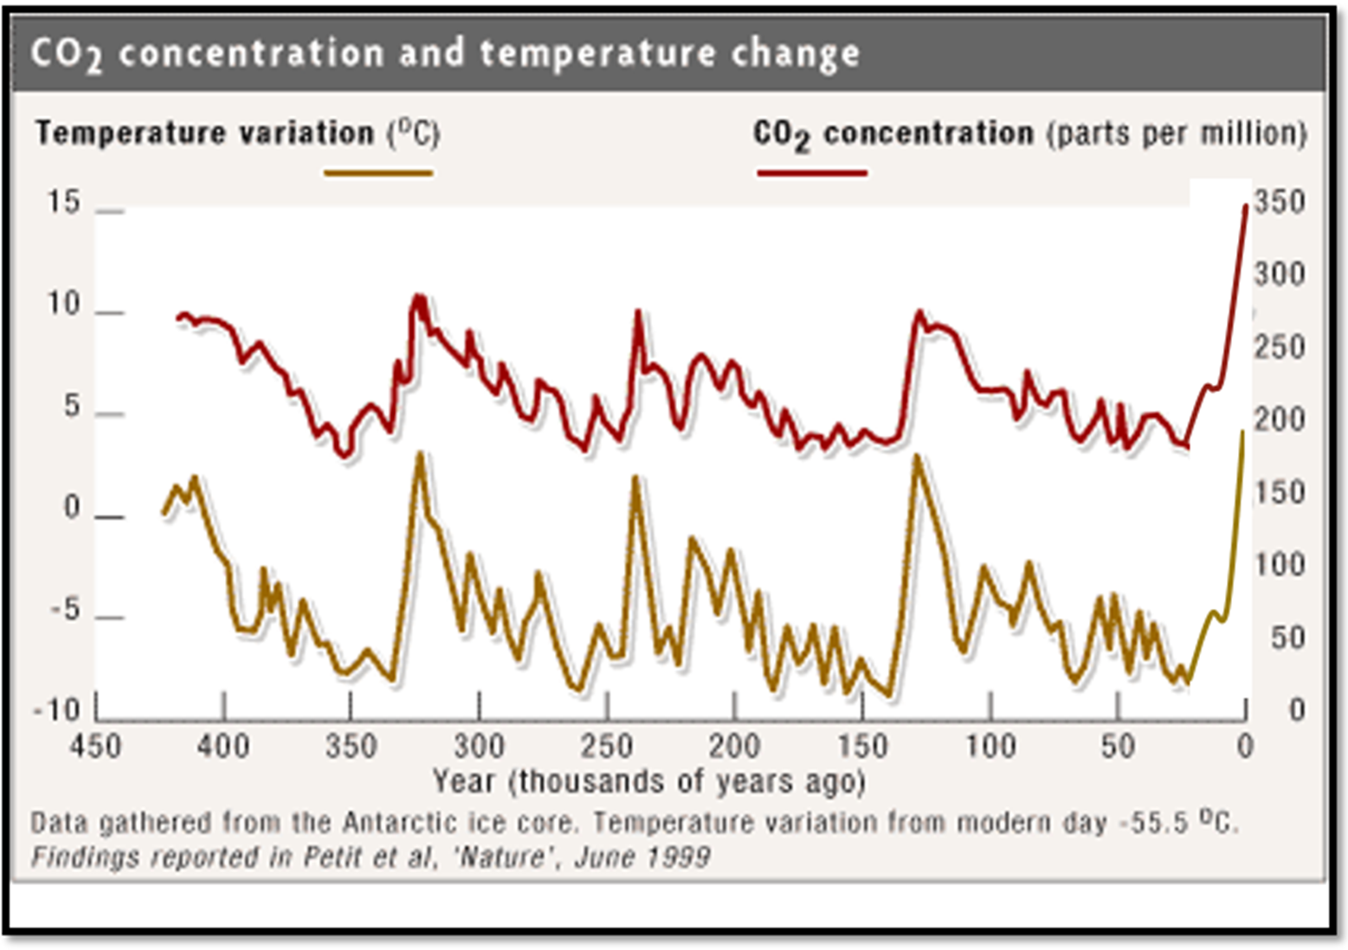
CLIMATE CHANGE TRENDS – Graph it!
Analyze the graph and answer the following questions…
  What unit is CO2 measured in?
  How many spikes in global temperature has their been in the past 400,000 years?
  What is the correlation between the amount of CO2 and the global temperature?
  What happened to the global temperature after the use of fossil fuels in comparison to the time period before the use of fossil fuels?
  Do humans have an impact in global warming? Why or why not?
Make copies of the two graphs and pass them out to the students.
Resource 10

Slide 24
Analyze the graph and answer the following questions…
  What unit is CO2 measured in? PPM – parts per million
  How many spikes in CO2 has their been in the past 400,000 years? 5 spikes of CO2 emissions in the last 400,000 years
  How many spikes in global temperature has their been in the past 400,000 years? 5 spikes in global temperature
  What is the correlation between the amount of CO2 and the global temperature? As the CO2 increases, so does the temperature.
  What happened to the global temperature after the use of fossil fuels in comparison to the time period before the use of fossil fuels? The CO2 and temperature continue to rise higher than any time before the use of fossil fuels.
  Do humans have an impact in global warming? Why or why not? YES! The amount of CO2 and temp change is greater than any time period before humans were alive.

Slide 25
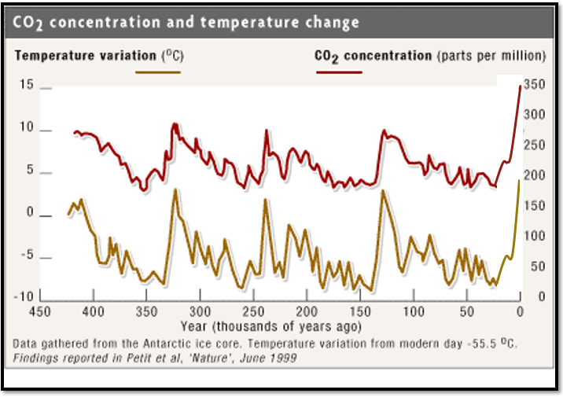
Based on this data from ice cores, do you agree that global warming is real or not? Explain…

Slide 26
Warm-Up Day of Week Date
Question:
Do humans have an impact in global warming? Why or why not?
Answer:
  YES! The amount of CO2 and temp change is greater than any time period before humans were alive.

Slide 27
Chapter 2 – Evidence

Slide 28
Climate Change: How do we know?
Read the article
Create a One Pager
Summarize- in 10 Words
Predict- (before or after what will happen)
Clarify- 3 pieces of evidence for climate change
Question- 2 questions about the article
Visualize- 1 picture with color

Slide 29
Warm Up
What is the major way humans cause global climate change?

Slide 30
Green House Gasses (optional)
pHet Simulation

Slide 31
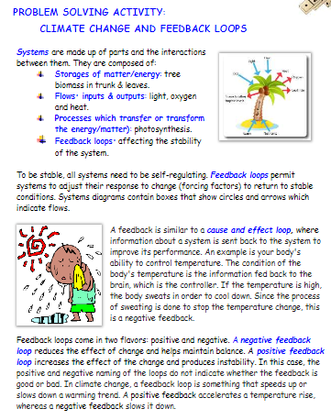
Climate Change Feedback Loop

Slide 32
Climograph Activity

Slide 33
Is the Earth Getting Warmer?
Circle any words you don’t know the definition
Write two questions – like would be on a worksheet per page of reading
Answer ALL the questions at the end.
Hand in at the end of class

Slide 34
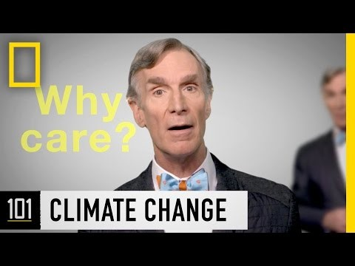
Effects of Climate Change
click here to see Bill Nye explain the effects of climate change

Slide 35
Warm Up
How much water do you think you use per day? Estimate in gallons.

Slide 36
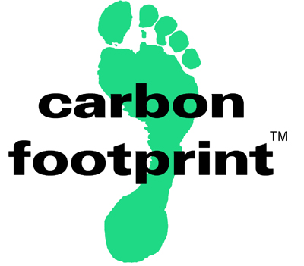
Our Carbon Footprint
click here to learn about the carbon footprint (show this one! 3 mins)
Think about it: if everybody lived your lifestyle, how many Earth’s would be needed in order to sustain life?
Higher carbon emissions leads to GLOBAL WARMING which causes CLIMATE CHANGE.
click here to learn about climate change - current issues

Slide 37
Our Carbon Footprint
Think about it: if everybody lived your lifestyle, how many Earth’s would be needed in order to sustain life?
Higher carbon emissions leads to GLOBAL WARMING which causes CLIMATE CHANGE.

Slide 38
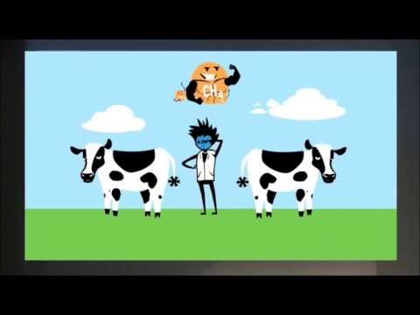
Guy explains carbon footprint
https://www.youtube.com/watch?v=JQAKPnVfWXM
Notes:
https://www.youtube.com/watch?v=JQAKPnVfWXM

Slide 39
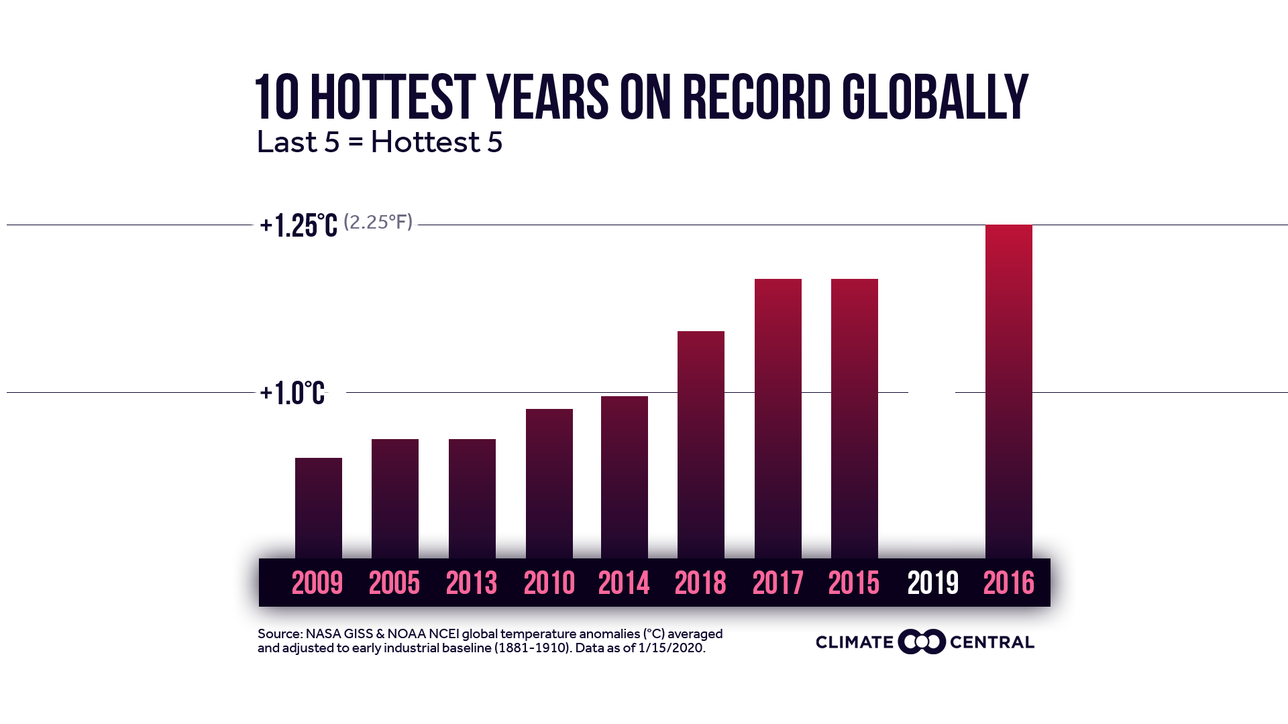
2021
Data as of 1/15/2020; Source: NASA

Slide 40
What is Your Carbon Footprint?
Let’s find out how many Earth’s would be needed if everybody lived your lifestyle.
Remember that Earth only has a limited amount of resources. Earth can only sustain about 10-12 billion people before we run out of room/resources such as clean water, food, fossil fuels, etc.
Go to the next slide for instructions…

Slide 41
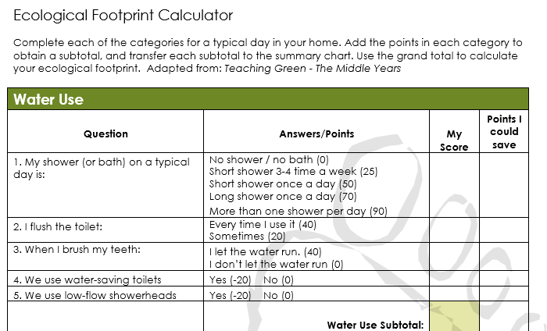
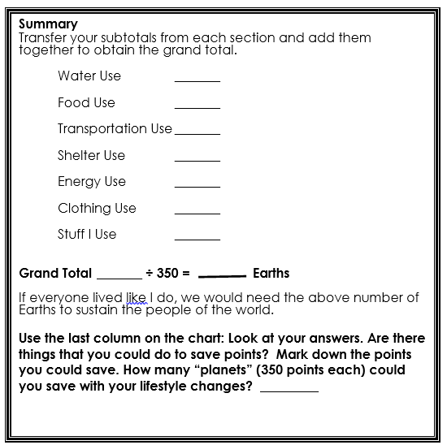
Carbon Footprint Activity
Distribute the Carbon Footprint Calculator and conduct the activity
Resource 11

Slide 42
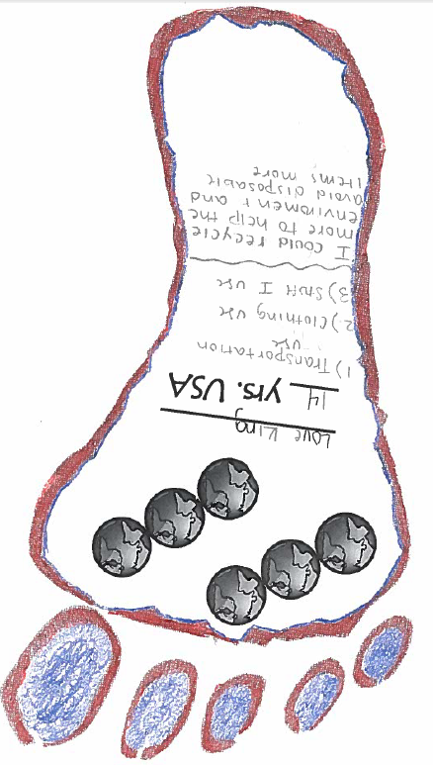
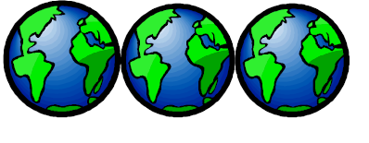
Once you complete the carbon footprint – create a footprint poster.
Resource 12
Include the number of earth’s
Student’s name and age
Block
Top 3 contributing factors
Ways to reduce the top 3 contributing factors
Resource 13

Slide 43
Comparison WS
Answer these after you answer the comparison questions- on the same sheet
How many Earth’s were needed if everybody lived your lifestyle?
If everybody in the class uses more than one Earth, why aren’t all the resources already gone?
Do you think other countries are as wasteful as we/you are?
How can YOU reduce your carbon footprint?

Slide 44

Warm-Up Day of Week Date
Question:
Explain how 7 billion people can live on Earth when you/our Carbon Footprint requires us to have more than one Earth of resources.
Answer:
Over half the population (developing countries) are not as wasteful and have VERY little impact on the Earth and its resources.

Slide 45
Albedo Lab

Slide 46
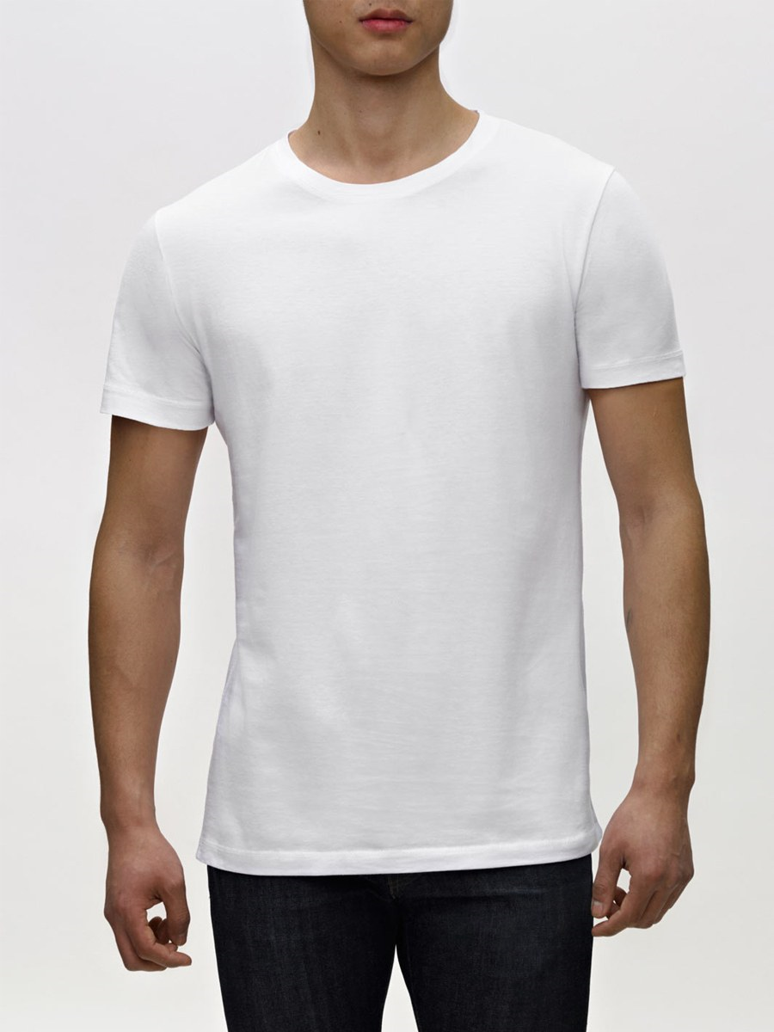
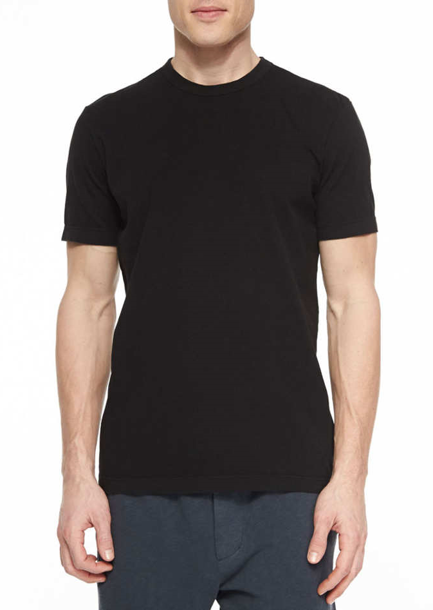
What color do you wear to stay cool?
OR
Albedo: fraction of light that is reflected by a body or surface
Notes:
Before

Slide 47
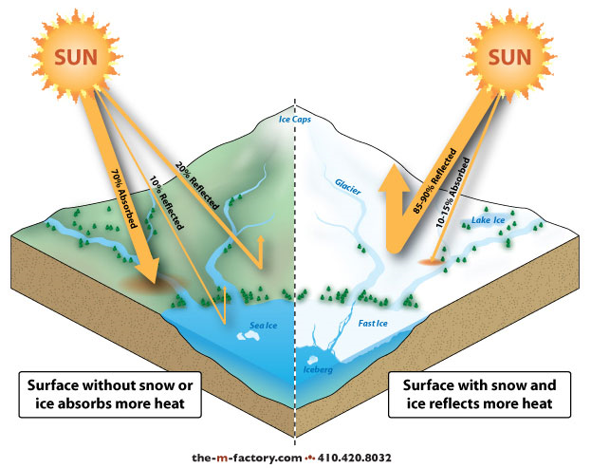
Albedo
Darker (land) absorbs heat energy
Light colored (ice caps) surfaces reflect energy
Ice caps melt, less energy is reflected back out into space.
What happens to the global temperature as our ice caps melt?
Notes:
Use as summary or put up as they finish the lab to help them draw their conclusions.

Slide 48
Albedo
Darker (land) absorbs heat energy
Light colored (ice caps) surfaces reflect energy
Ice caps melt, less energy is reflected back out into space.
What happens to the global temperature as our ice caps melt?
Notes:
Use as summary or put up as they finish the lab to help them draw their conclusions.

Slide 49
Albedo
The darker (land) surfaces on earth absorb more heat energy and the light colored (ice caps) surfaces reflect more energy.
As the ice caps melt, less heat is reflected back out into space.
What happens to the global temperature as our ice caps melt?
  The global temp increases because the earth is absorbing more heat – further increasing global warming.

Slide 50
What happens to something as it gets hot?
OR

Slide 51
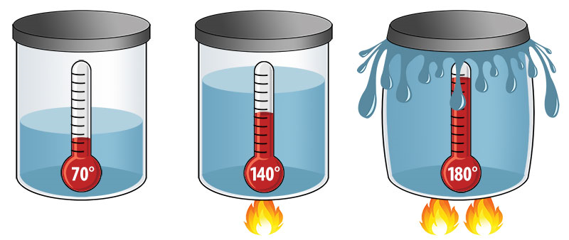
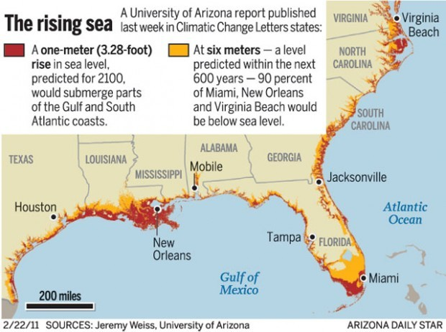
Thermal Expansion
click here to view interactive map
As something heats up, the molecules move faster and spread farther apart – expanding.
As the ocean heats up due to global warming, it begins to expand.
What will happen to the sea level if the ocean expands?
  IT WILL RISE!!!
The sea level is predicted to rise 230 feet if ALL the ice caps melted.
  The avg. elevation of Charles County is 220-240 feet above sea level.

Slide 52
Mercury Rising Article

Slide 53
Sea Level Change Graphing Activity

Slide 54
Rising Sea Level Reading and Quiz

Slide 55
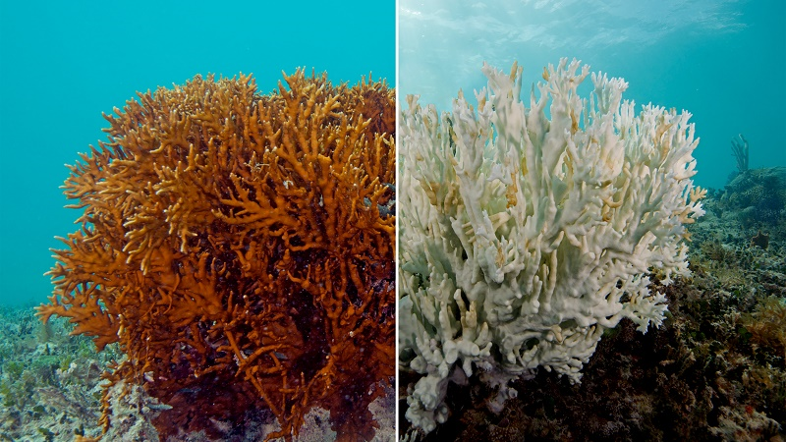
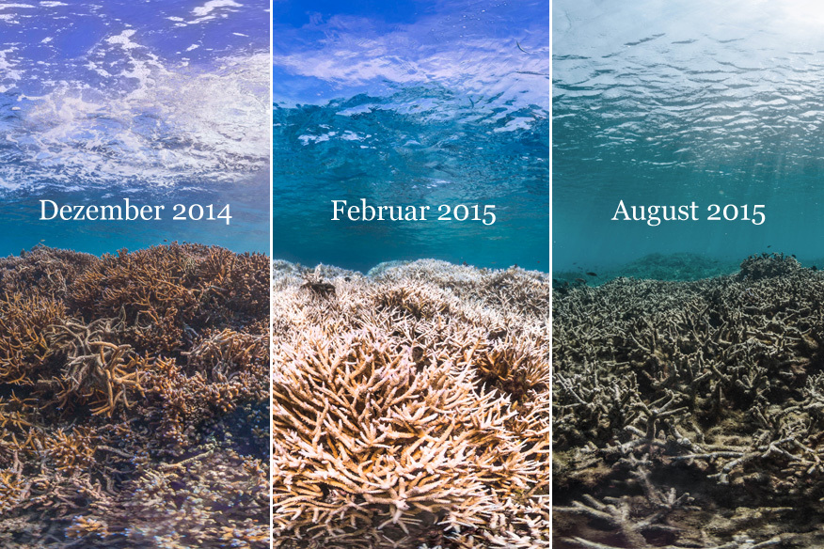
Coral Bleaching
Coral becomes stressed and can die due to increased water temperatures.
Destroys ecosystems and threatens life for thousands of other marine animals.
HEALTHY BLEACHED DEAD
December 2014
February 2015
August 2015

Slide 56
Chasing Coral Video (optional)

Slide 57
Hawaii Coral Article (Optional)

Slide 58
Ocean Acidification Lab

Slide 59
Glaciers Then and Now
You will match what the glaciers used to look like, with what they look like recently.
When you match fill in the chart:
Glacier Name
Solve- Figure out how many years in between the first photo of the glacier and the second photo
Things that are the same
Things that are different

Slide 60
Glacier Thickness Graph

Slide 61
Glacier Cloze Activity (fill in the blank reading)

Slide 62
Videos (optional)
Before the Flood
Cosmos Episode 12
The Lorax

